Slide 1
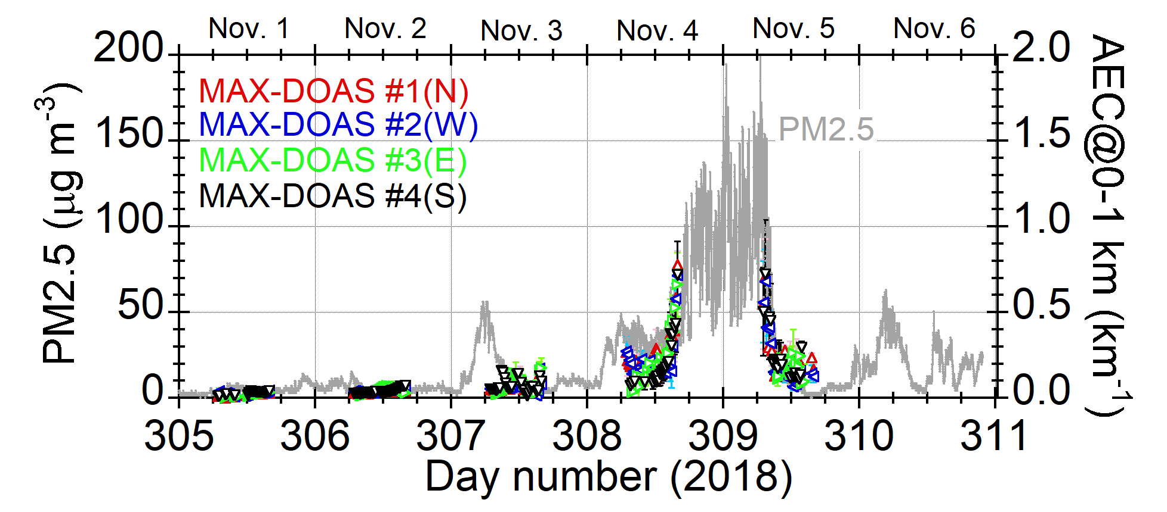
Comparison between PM2.5 data
and MAX-DOAS aerosol data (Nov. 1-6)
AEC = Aerosol Extinction Coefficient at 476 nm

Slide 2
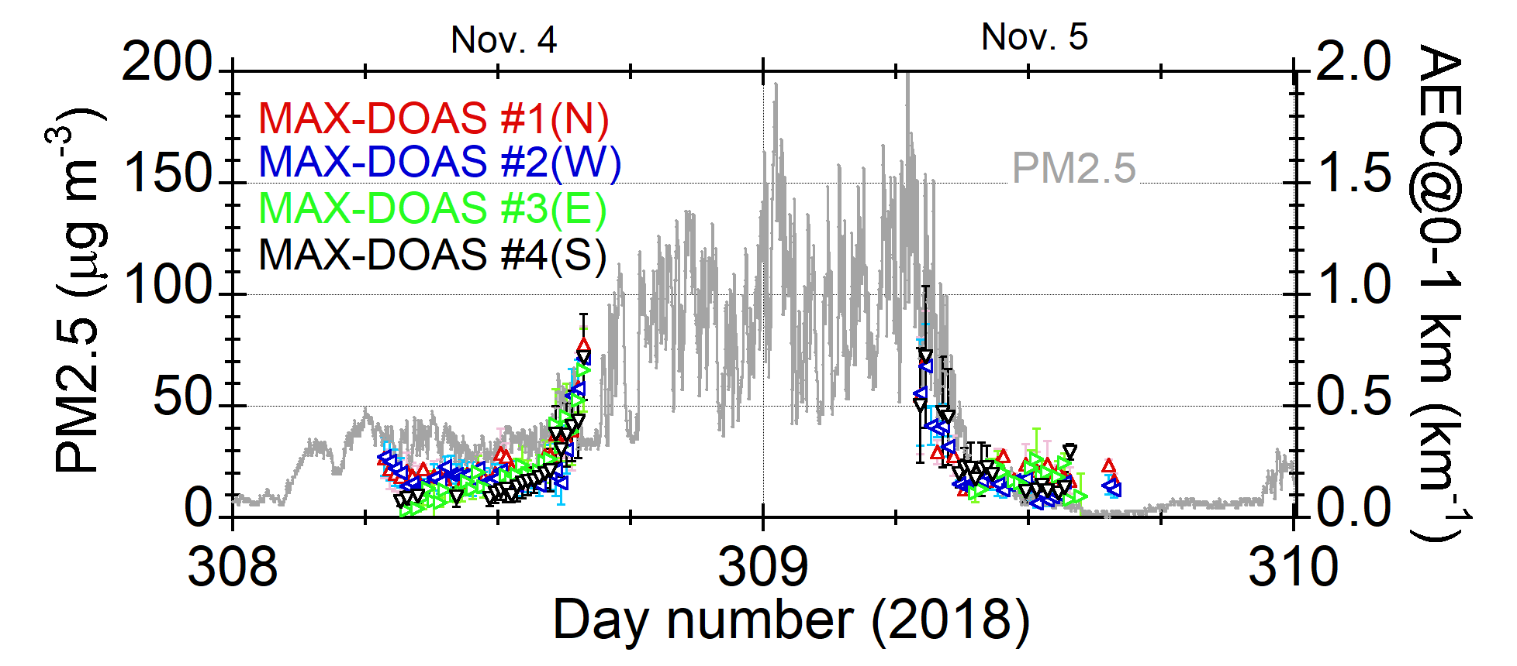
Comparison between PM2.5 data
and MAX-DOAS aerosol data (Nov. 4-5)
AEC = Aerosol Extinction Coefficient at 476 nm

